Slide 1

Folium modules
PRESENTERS:
Suresh Bhandari(3)
Diwash Tamang(26)
Yashwant Singh(25)
Aashish Basnet(32)
Presented to:
Uma Sankhar Pandey
Department Of Civil and Geomatics Engineering

Slide 2
Introduction
folium builds on
the data wrangling strengths of the Python ecosystem
mapping strengths of the leaflet.js library
Manipulate your data in Python, then visualize it in on a Leaflet map via folium.

Slide 3
Classes in Folium Modules
There are various packages used to make map interactive. Some of them are described below:
Map
Generate a base map of given width and height with either default tilesets or a custom tileset URL.
Code Snippet:
class folium.folium.Map(location=None, tiles='OpenStreetMap', zoom_start=10)

Slide 4
Cont...
2. . Icon
class folium.map.Icon(color='blue', icon_color='white',, angle=0)
Parameters: | color (str, default 'blue') –The color of the marker. icon_color (str, default 'white') – The color of the drawing on the marker. angle (int, default 0) – The icon will be rotated by this amount of degrees.

Slide 5
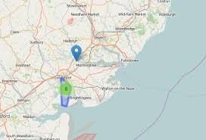
cont...
3. Marker
Creates a simple stock leaflet marker on the map, with optional popup text or vincent visualization.
class folium.map.Marker
Parameters: | location (tuple or list, default None) – Latitude and Longitude of Marker (Northing, Easting) popup (string or folium.Popup, default None) – Input text or visualization for object. icon (Icon plugin) – the Icon plugin to use to render the marker.

Slide 6
DEMONSTRATION

Slide 7
CIRCLE
Class for drawing circle overlays on a map.
A package called vector_layers is has to be imported for drawing geometric shapes in the map.
Code snippet:
class folium.vector_layers.Circle(location, radius, popup=None, tooltip=None)

Slide 8
CIRCLE
Parameters:
locations (list of points (latitude, longitude)) – Latitude and Longitude of line (Northing, Easting)
popup (string or folium.Popup, default None) – Input text or visualization for object displayed when clicking.
tooltip (str or folium.Tooltip, default None) – Display a text when hovering over the object.
radius (float) – Radius of the circle, in meters.

Slide 9
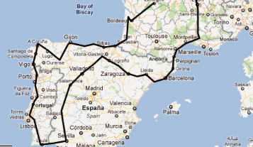
POLYLINE
Class for drawing polyline overlays on a map.
Code snippet:
class folium.vector_layers.PolyLine(locations, popup=None, tooltip=None,)

Slide 10
RECTANGLE
Class for drawing rectangle overlays on a map
Code snippet:
class folium.vector_layers.Rectangle(bounds, popup=None, tooltip=None)

Slide 11
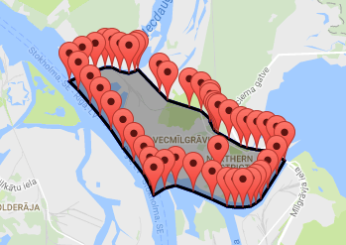
POLYGON
Class for drawing polygon overlays on a map.
Code snippet:
class folium.vector_layers.Polygon(locations, popup=None, tooltip=None)

Slide 12
DEMONSTRATION

Slide 13
TileOverlay
Add a tile layer to the map.
class: folium.map.TileLayer
Parameters: tiles (str, default 'OpenStreetMap')
min_zoom (int, default 1)
max_zoom (int, default 18)
attr (string, default None)
name (string, default None)
control (bool, default True)
overlay (bool, default False)

Slide 14
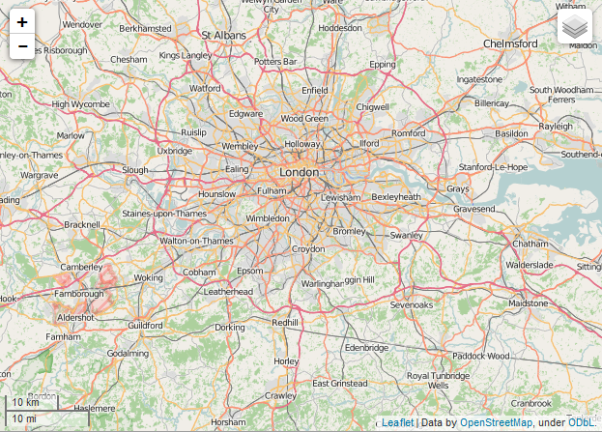
OPEN STREET MAP
Folium defaults to using openstreetmap tiles. You can also access these tiles with:
folium.TileLayer('openstreetmap').add_to(my_map)

Slide 15
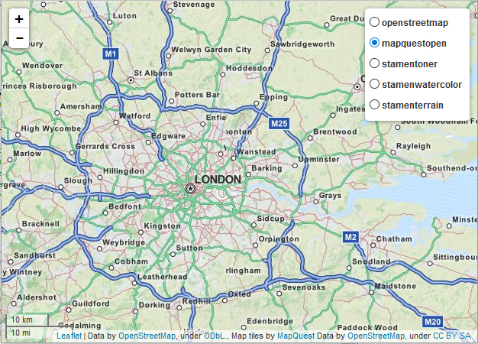
Map Quest Open
Similar to open street map, mapquestopen tiles are a good general purpose tile set.
folium.TileLayer('mapquestopen').add_to(my_map)

Slide 16
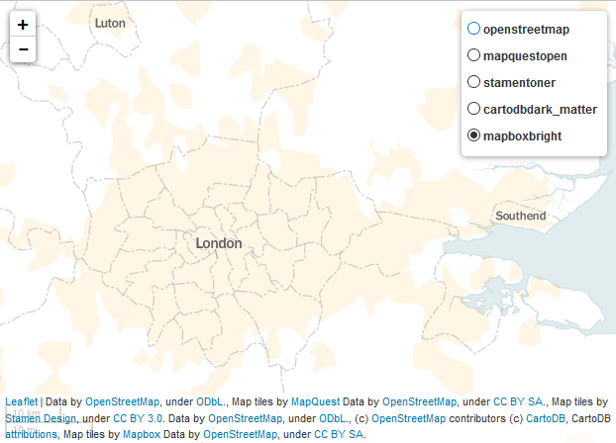
Mapbox Bright
Mapbox makes some nice map tiles, but the free versions only have limited levels of zoom available (i.e. you can’t zoom close in).
folium.TileLayer('Mapbox Bright').add_to(my_map)

Slide 17
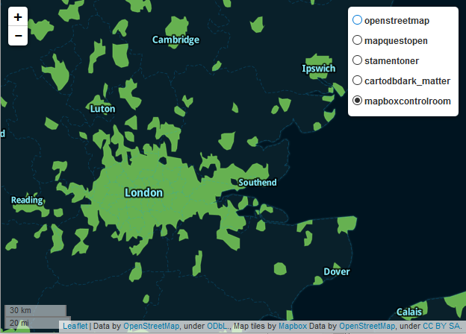
Mapbox Control Room
Control Room is another set of MapBox tiles. Again there are only limited levels of zoom available for the free version, but they do look cool.
folium.TileLayer('Mapbox Control Room').add_to(my_map)

Slide 18
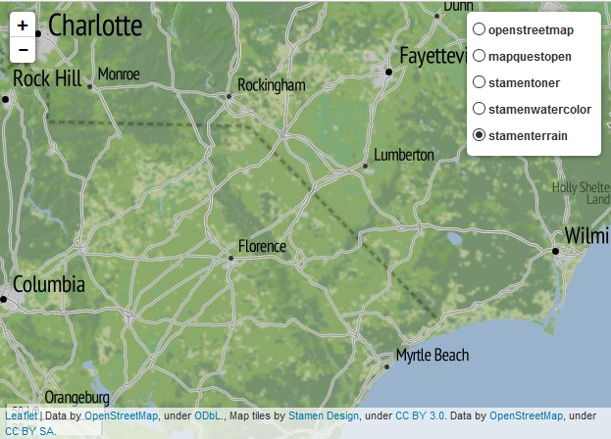
Stamen Terrain
Stamen also produce some cool map tiles which typically work at all zoom levels. These terrain tiles are only available for the USA unfortunately.
folium.TileLayer('stamenterrain').add_to(my_map)

Slide 19
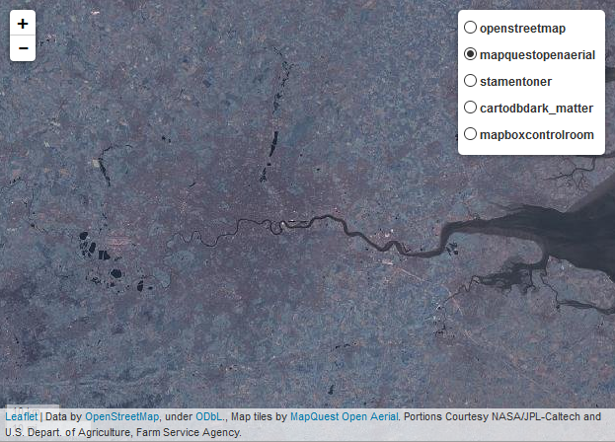
MapQuest Open Aerial
Mapquest also provides open aerial photography to use as map tiles:
folium.TileLayer('MapQuest Open Aerial').add_to(my_map)

Slide 20
VideoOverlay
Used to load and display a video over the map.
class folium.plugins.VideoOverlay(video_url, bounds, opacity=1.0, autoplay=True, loop=True)
Parameters:
video_url (URL of the video) –
bounds (list) – Video bounds on the map in the form [[lat_min, lon_min], [lat_max, lon_max]]
opacity (float, default Leaflet's default (1.0))

Slide 21
DEMONSTRATION

Slide 22
LayerControl
class folium.map.LayerControl(position='topright', collapsed=True, autoZIndex=True)
Creates a LayerControl object to be added on a folium map.
Parameter
position (str) – The position of the control (one of the map corners), can be ‘topleft’, ‘topright’, ‘bottomleft’ or ‘bottomright’ default: ‘topright’
collapsed (boolean) – If true the control will be collapsed into an icon and expanded on mouse hover or touch. default: True
autoZIndex (boolean) – If true the control assigns zIndexes in increasing order to all of its layers so that the order is preserved when switching them on/off. default: True

Slide 23
Choropleth
choropleth(geo_data, data=None, columns=None, key_on=None, fill_color='blue', line_opacity=1, name=None, legend_name='')
Apply a GeoJSON overlay to the map.
Bind geojson with data passed as a Pandas DataFrame
Parameters
geo_data (string/object) – URL, file path, or data (json, dict, geopandas, etc) to your GeoJSON geometries
data (Pandas DataFrame or Series, default None) – Data to bind to the GeoJSON.
columns (dict or tuple, default None) – If the data is a Pandas DataFrame, the columns of data to be bound. Must pass column 1 as the key, and column 2 the values.
key_on (string, default None) – Variable in the GeoJSON file to bind the data to. Must always start with ‘feature’ and be in JavaScript objection notation. Ex: ‘feature.id’ or ‘feature.properties.statename’.
fill_color (string, default 'blue') – Area fill color. Can pass color name, or if you are binding data, one of the following colorbrewer palettes: ‘BuGn’, ‘BuPu’, ‘GnBu’, ‘OrRd’, ‘PuBu’, ‘PuBuGn’, ‘PuRd’, ‘RdPu’, ‘YlGn’, ‘YlGnBu’, ‘YlOrBr’, and ‘YlOrRd’.

Slide 24
GeoJson
class folium.features.GeoJson(data, name=None, overlay=True, control=True, highlight_function=None)
data (file, dict or str.) – The GeoJSON data you want to plot.
name (string, default None) – The name of the Layer, as it will appear in LayerControls
overlay (bool, default False) – Adds the layer as an optional overlay (True) or the base layer (False).
control (bool, default True) – Whether the Layer will be included in LayerControls

Slide 25
DEMONSTRATION

Slide 26
Advantages
Visualization of the geospatial data (through maps)
Interactive map design
Spatial analysis (heatmaps, time analysis)
Useful for geospatial application development

Slide 27
THANK YOU

